Slide 1
Intersystem Communication :Architectures for Integrating Systems
CORBA is an abbreviation for Common Object Request Broker Architecture.
CORBA is a standard defined by the Object Management Group (OMG) that enables software components written in multiple computer languages and running on multiple computers to work together (i.e., it supports multiple platforms).
CORBA is based on the Request-Response architecture
There is an object implementation on the server, which the client requests to execute
The client and the server object implementation can be located on the same node, or can be located on separate nodes

Slide 2
Cont..
Focus on integration of systems and applications across heterogeneous platforms.
After soliciting input, CORBA standard was defined and introduced in 1991.
The only REAL competitor is, of course…MICROSOFT DCOM.
Thus CORBA allows applications and their objects to communicate with each other no matter where they are and or who designed them!!
When introduced in 1991, CORBA defined the Interface Design Language, (IDL) and Application Programming Interface, (API).
These allow client/server interaction within a specific implementation of an Object Request Broker, (ORB).
The client sends an ORB request to the SERVER/OBJECT IMPLEMENTATION and this in turn returns back either ORB Result or Error to the client.
CORBA is just a specification for creating and using distributed objects

Slide 3
CORBA Architecture
The CORBA architecture is based on the object model.
A CORBA-based system is a collection of objects that isolates the requestors of services (clients) from the providers of services(servers) by a well-defined encapsulating interface.
CORBA is composed of five major components:
ORB, IDL, dynamic invocation interface(DII),
interface repositories (IR), and object adapters (OA).

Slide 4
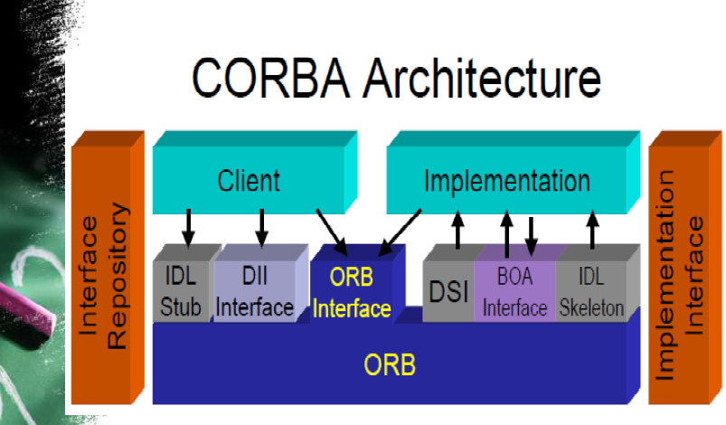
CORBA Architecture

Slide 5
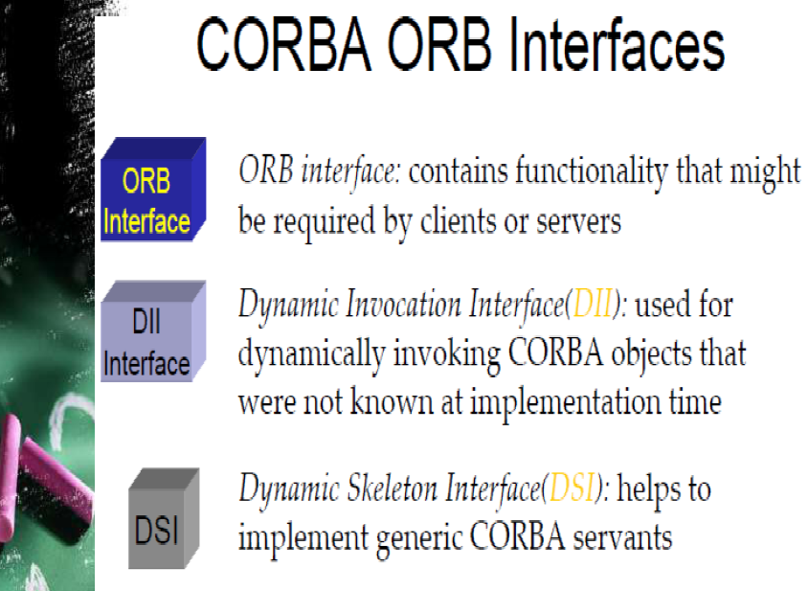

Slide 6
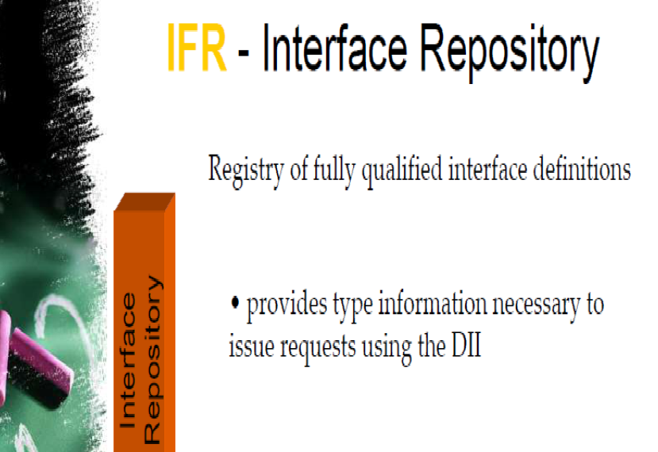

Slide 7
Dynamic skeleton interface
Analogous to the DII is the server-side dynamic skeleton interface (DSI), which allows servers to be written without having skeletons, or compile-time knowledge, for the objects being implemented.
Unlike DII, which was part of the initial CORBA specification, DSI was introduced in CORBA 2.0.
Its main purpose is to support the implementation of gateways between ORBs which utilize different communication protocols.

Slide 8
Object Request Broker (ORB)
For objects to communicate across the network, they need a communication infrastructure named Object Request Broker (ORB). ORB is core of any COBRA Distributed System.
ORB is responsible for enabling communication between objects and their clients while hiding and issues related to distribution and heterogeneity.
CORBA use the remote object model in which and the implementation of an object reside in the and address space of a server.
Both client and object implementation are isolated from the ORB by an IDL interface.
Clients see only the object’s interface, never the implementation.
To communicate, the request does not pass directly from client to object implementation, instead every request is passed to the client’s local ORB, which manages it.

Slide 9
Object Request Broker (ORB)
The interface the client sees is completely independent of where the object is located, what programming language it is implemented in, or any other aspect that is not reflected in the object’s interface.
The ORB is responsible for:
Finding the object implementation for the request,
Preparing the object implementation to receive the request,
communicating the data making up the request.

Slide 10
Object Request Broker (ORB)
Intercepts calls
Finds object
Invokes method
Passes parameters
Returns results or error messages
REGARDLESS OF THE OBJECTS LOCATION, ITS PROGRAMMING LANGUAGE OR EVEN THE OPERATING SYSTEMS INVOLVED!!

Slide 11
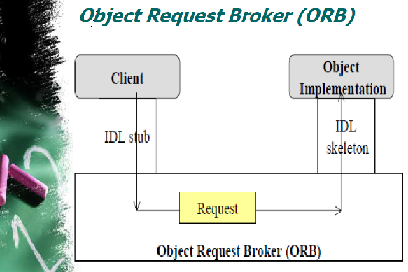
Object Request Broker (ORB)

Slide 12
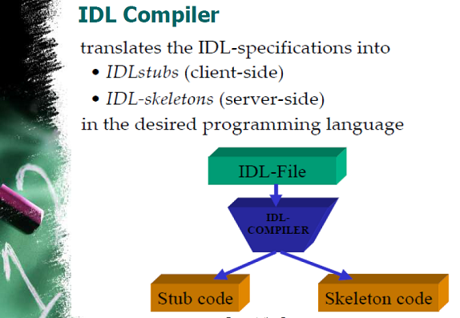
IDL Compiler

Slide 13
Interface Repository
The IR provides another way to specify the interfaces to objects.
Interfaces can be added to the interface repository service.
Using the IR, a client should be able to locate an object that is unknown at compile time, find information about its interface, then build a request to be forwarded through the ORB.

Slide 14
ORB Interface
An ORB is a logical entity that may be implemented in various ways
To decouple applications from implementation details, the CORBA specification defines an abstract interface for an ORB.
  This interface provides various helper functions
    Converting object references to strings and vice versa
    Creating argument lists for requests made through the dynamic invocation interface.

Slide 15
CORBA IDL Stubs and Skeletons
CORBA IDL stubs and skeletons serve as the ``glue'' between the client and server applications, respectively, and the ORB.
The transformation between CORBA IDL definitions and the target programming language is automated by a CORBA IDL compiler.
  The use of a compiler reduces the potential for inconsistencies between client stubs and server skeletons and increases opportunities for automated compiler optimizations.

Slide 16
Dynamic Invocation Interface (DII)
Invoking operations can be done through either static or dynamic interfaces.
Static invocation interfaces are determined at compile time, and they are presented to the client using stubs.
The DII, on the other hand, allows client applications to use server objects without knowing the type of those objects at compile time.
It allows a client to obtain an instance of a CORBA object and make invocations on that object by dynamically constructing requests.
The CORBA DII presents an API that enables objects and their methods to be specified and called at run-time
This interface allows a client to directly access the underlying request mechanisms provided by an ORB.

Slide 17
Dynamic Invocation Interface (DII)
DII uses the interface repository to validate and retrieve the signature of the operation on which a request is made.
CORBA supports both the dynamic and the static invocation interfaces.

Slide 18
CORBA Objects
It is important to note that CORBA objects differ from typical programming objects in three ways:
CORBA objects can run on any platform.
CORBA objects can be located anywhere on the network.
CORBA objects can be written in any language that has IDL mapping.

Slide 19
CORBA works with interfaces
All CORBA Objects are encapsulated.
Objects are accessible through interface only.
Separation of interfaces and implementation enables multiple implementations for one interface

Slide 20
Interface description language (IDL)
IDL is a specification language used to describe a software component's interface.
IDLs describe an interface in a language neutral way, enabling communication between software components that do not share a language.
for ex., between components written in C++ and components written in Java.
IDLs are commonly used in remote procedure call software.
In these cases the machines at either end of the "link" may be using different operating systems and computer languages.
IDLs offer a bridge between the two different systems.

Slide 21
Dynamic Skeleton Interface (DSI)
The DSI allows an ORB to deliver requests to an object implementation that does not have compile-time knowledge of the type of the object it is implementing.

Slide 22
Object Adapter
An object adapter is the primary means for an object implementation to access ORB services such as object reference generation.
One of the object adaptor's functions is to map from object reference to an object
This assists the ORB with delivering requests to the object and with activating the object.
An object adapter associates object implementations with the ORB

Slide 23
STEPS in Developing the CORBA application
STEP 1: Defining object interfaces-The first step in creating an application is to specify all of your objects and their interfaces using the OMG's Interface Definition Language (IDL).
STEP 2: Generating client stubs and server skeleton
Use IDL compiler:
  Client Stub Code
  Server Skeleton Code

Slide 24
Cont..
STEP 3: Write the client
STEP 4: Write the server object implementation code
STEP 5: Compile the client and server code
STEP 6: Start the server
STEP 7: Run the client application

Slide 25
Benefits of CORBA
Programming-language independent interface.
Legacy integration
Rich distributed object infrastructure.
Object Location transparency.
Network transparency
Direct object communication.
Dynamic Invocation Interface.
Operating System Transparency

Slide 26
Object Location transparency
The client does not need to know where an object is physically located. An object can either be linked into the client, run in a different process on the same machine, or run in a server on the other side of the planet. A request invocation looks the same regardless, and the location of an object can change over time without, breaking applications.

Slide 27
Language Transparency
Client and server can be written in different languages. This fact encapsulates the whole point of CORBA; that is, the strengths of different languages can be utilized to develop different aspects of a system, which can interoperate through IDL. A server can be implemented in a different language without clients being aware of this.

Slide 28
Operating System Transparency
Client and server are unaffected by each other's operating system. In addition, source code does not change if you need to port the source from one operating system to another

Slide 29
Protocol Transparency
Clients and servers do not care about the data link and transport layer. They can communicate via token ring, Ethernet, wireless links, ATM (Asynchronous Transfer Mode), or any number of other networking technologies.

Slide 30
DCOM (Distributed Component Object Model)
DCOM is set of Microsoft concepts and program interface in which client program object can request services from server program objects on the others computers in a network.
DCOM is the distributed extension to COM (Component Object Model) that builds an object remote procedure call (ORPC) layer on top of DCE RPC to support remote objects
COM is a component based development model for Windows environment

Slide 31
Cont..
Component is a reusable piece of software that can be plugged into other components from other vendors with little effort
COM supports component interaction on local machine
DCOM provides the same functionality but across machines over a network.

Slide 32
Cont..
In both COM and DCOM, remote method calls are synchronous.

